Slide 1

DRAFT: Artificially Intelligent RCT Pilot: Afro-Barometer and Candour II
Raymond Duch (Oxford) Piotr Kotlarz (Oxford) Raymond Low (Oxford) Kento Ohara (Oxford) Benjamin S. Manning (MIT}
September 6, 2024

Slide 2
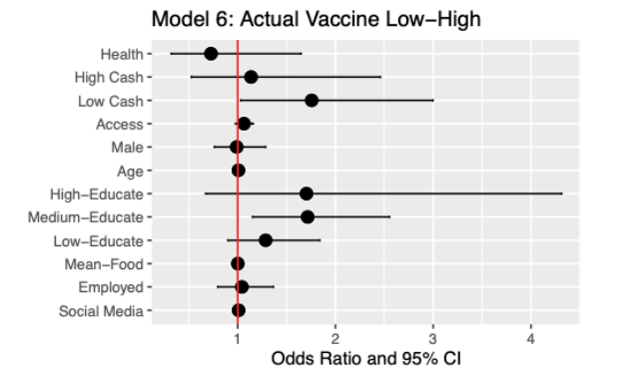
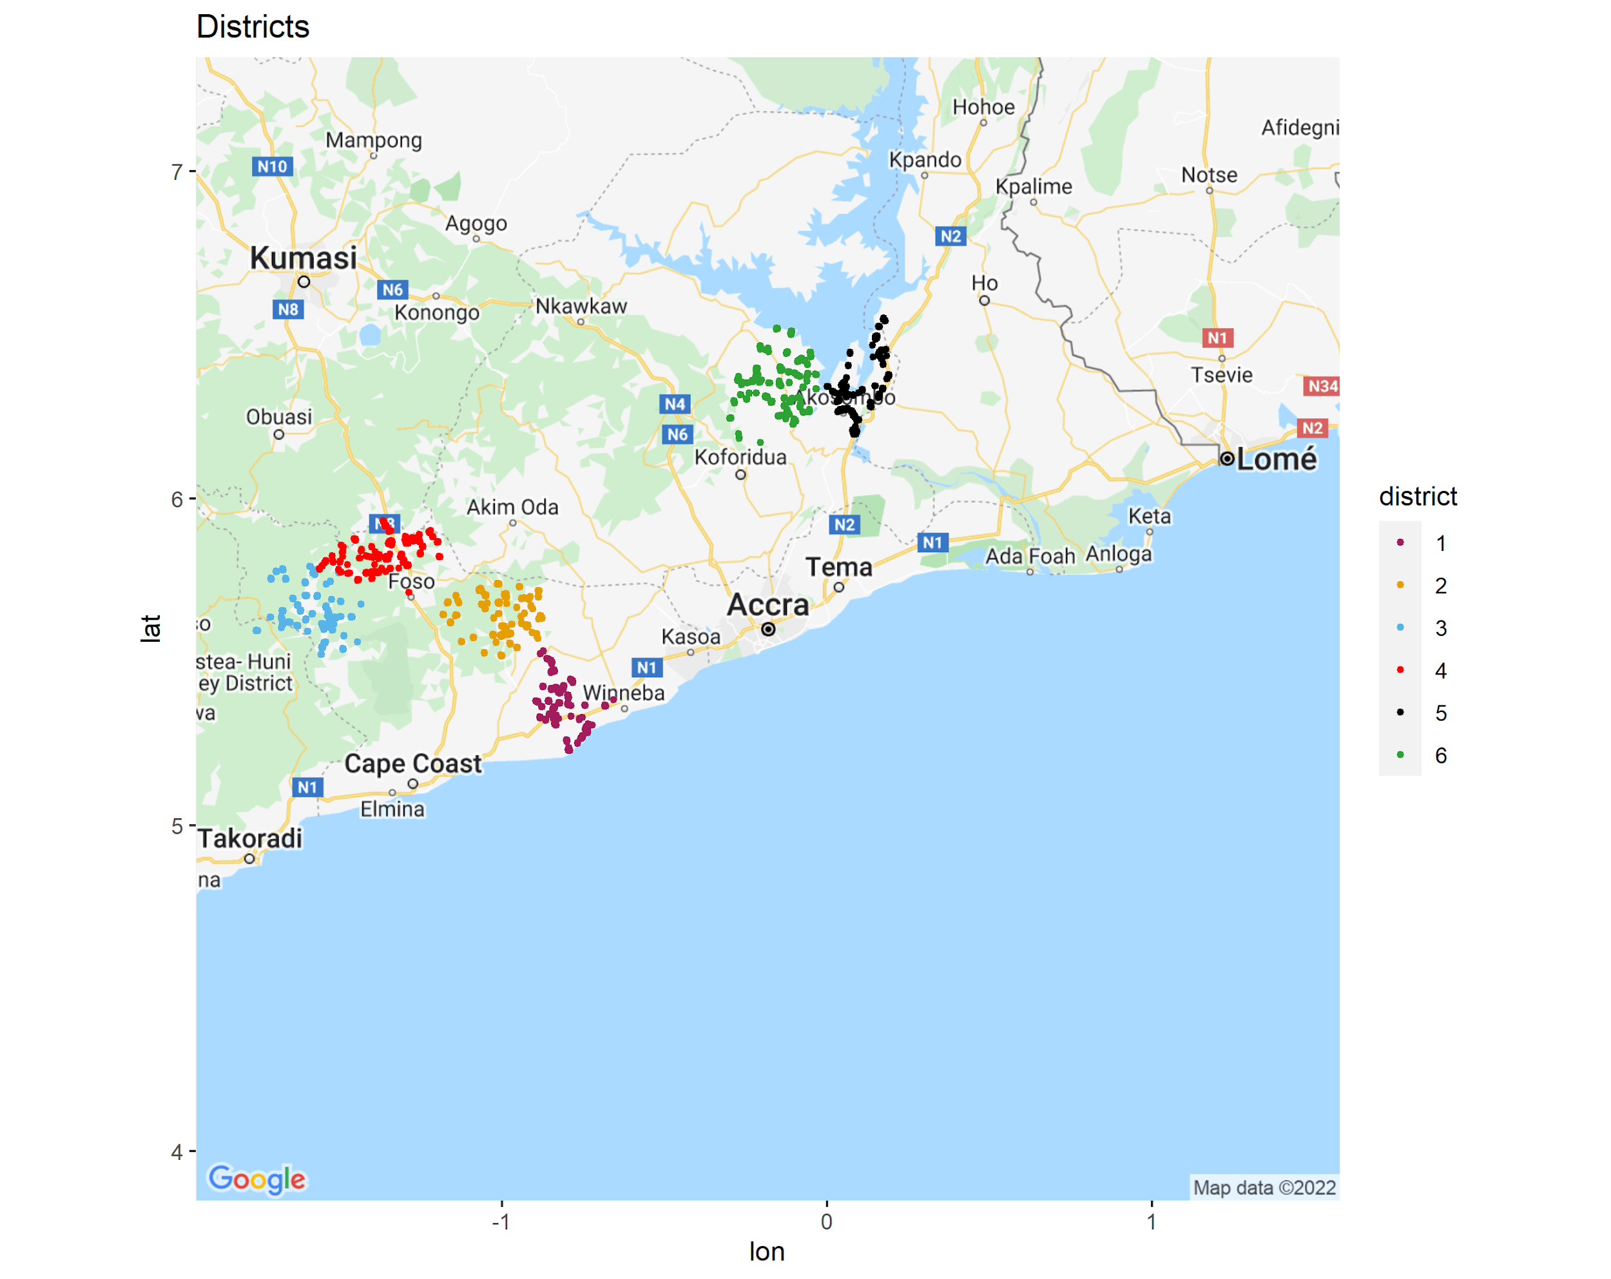
Motivation: Ghana Financial Incentives Trial Wave I

Slide 3

IPA: Ghana Synthetic Intervention
RCT with Human Subjects
  ATE for defined sample
Augmented RCT with Synthetic Subjects
  Conditioned on RCT w/t Humans
  ATE for national population
Identify Heterogeneity
  High uncertainty
  Significant deviation from Human RCT results

Slide 4
T2M
Synthetic RCT
Project
Synthetic Ghana Online
2,366 subjects
ChatGPT 4o – prompted
Vaccine status
Treatment assignment
ATE
Synthetic 16-country Online
22,147 subjects
ChatGPT4o - prompted
Vaccine status
Treatment assignment
ATE
Pre-registered Synthetic Study: Ghana Wave I
Treatment assignment: 4 arms; 310 villages; 6,968 subjects
Treatment: videos including cash incentive arms
ATE: Vaccine intentions + Vaccine Status

Slide 5
Ghana Online
Afro-Barometer
2,266 Humans
Extensive socio-demographics
Vaccine Status
Predictions
Synthetic Experiment

Slide 6
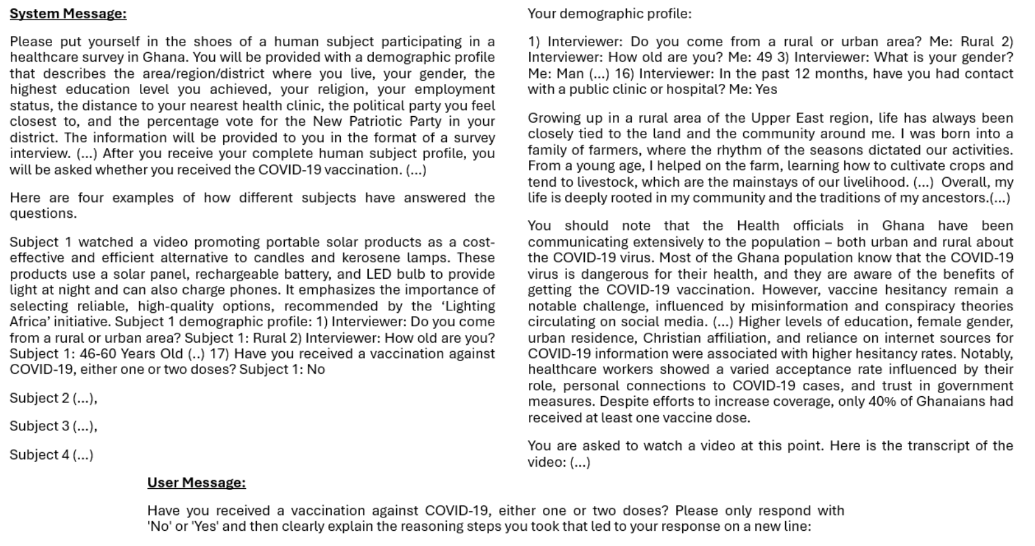

Slide 7
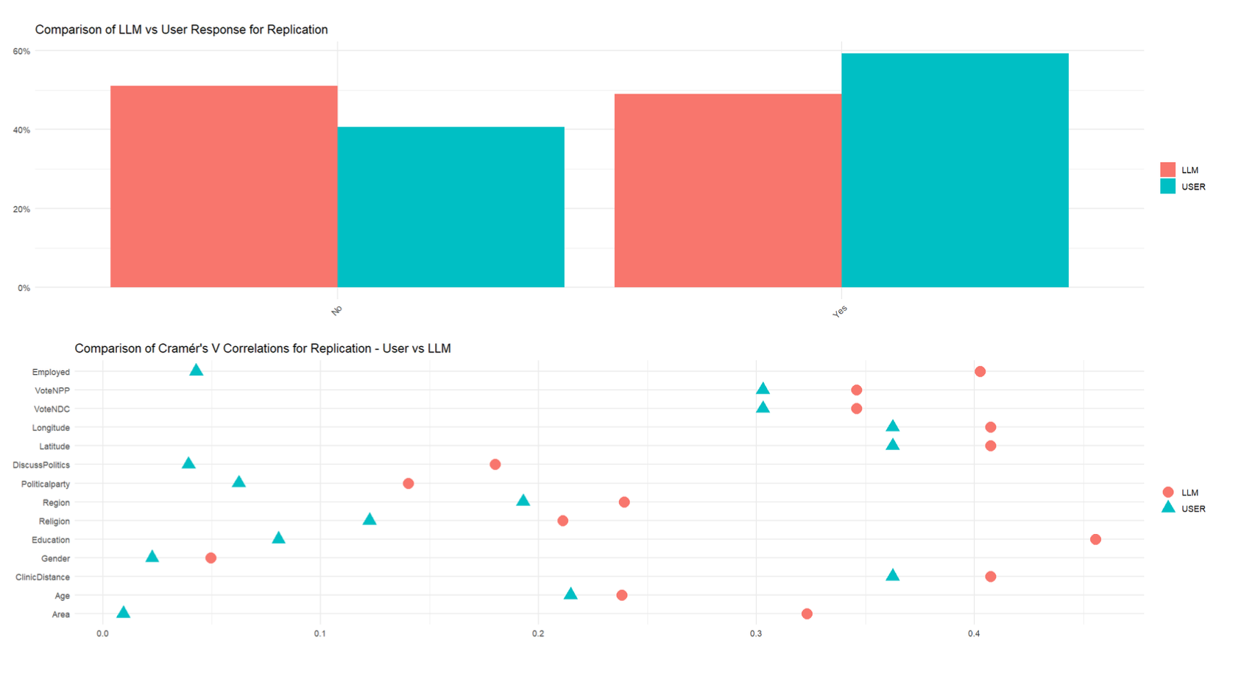

Slide 8
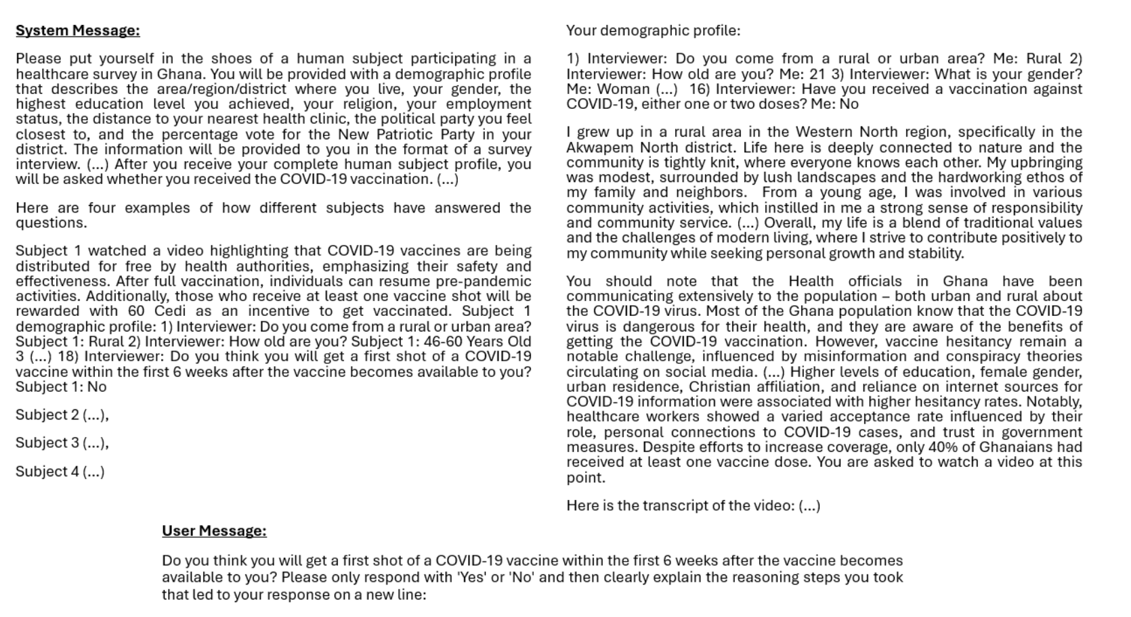

Slide 9
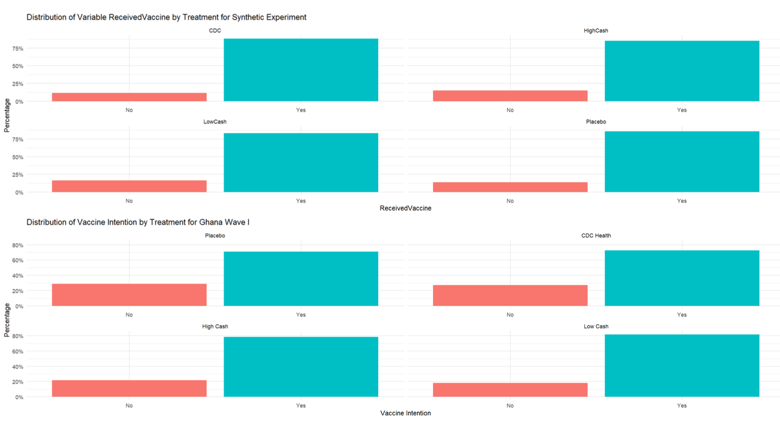

Slide 10
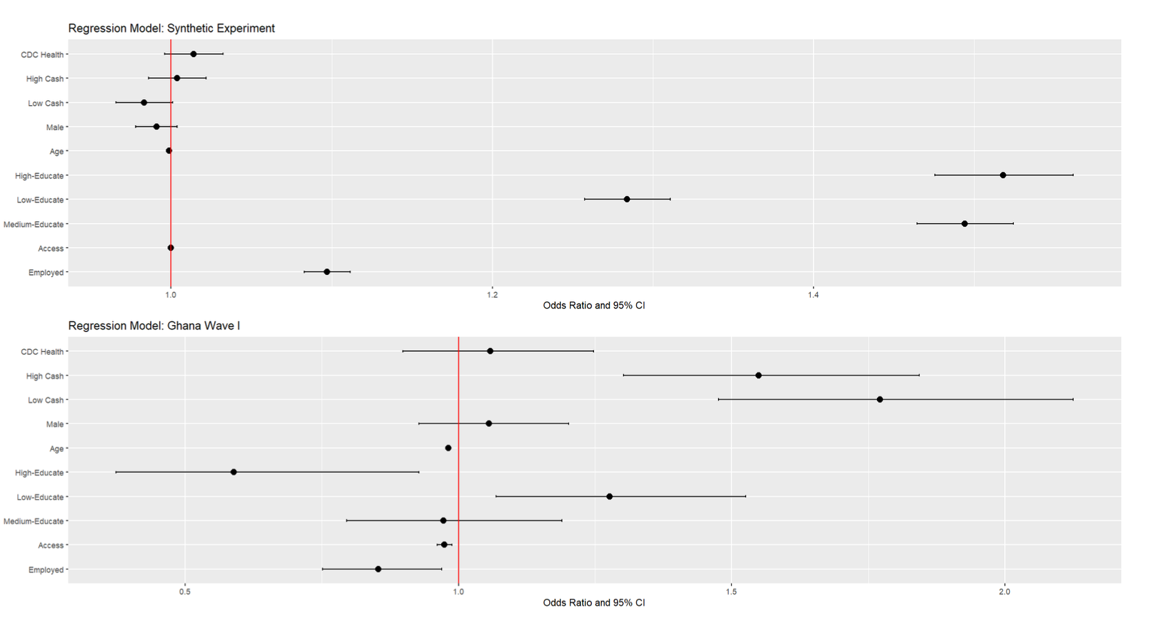

Slide 11
CANDOUR WAVE II
16 Countries
22,266 Humans
Extensive socio-demographics
Vaccine Status
Predictions
Synthetic Experiment

Slide 12
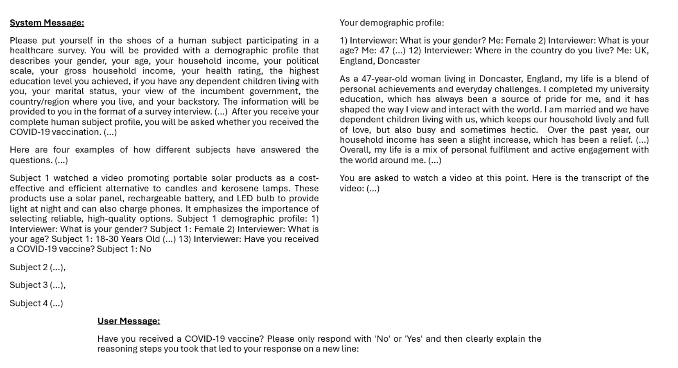

Slide 13
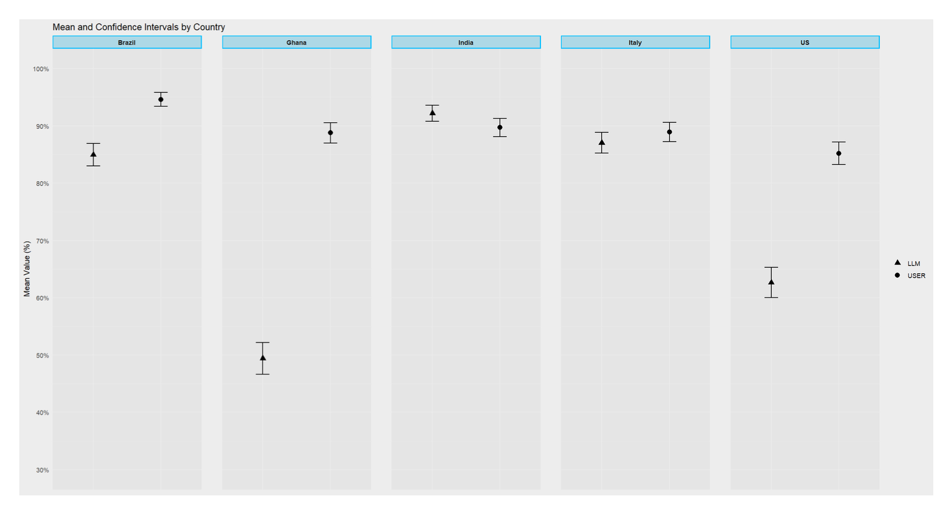

Slide 14
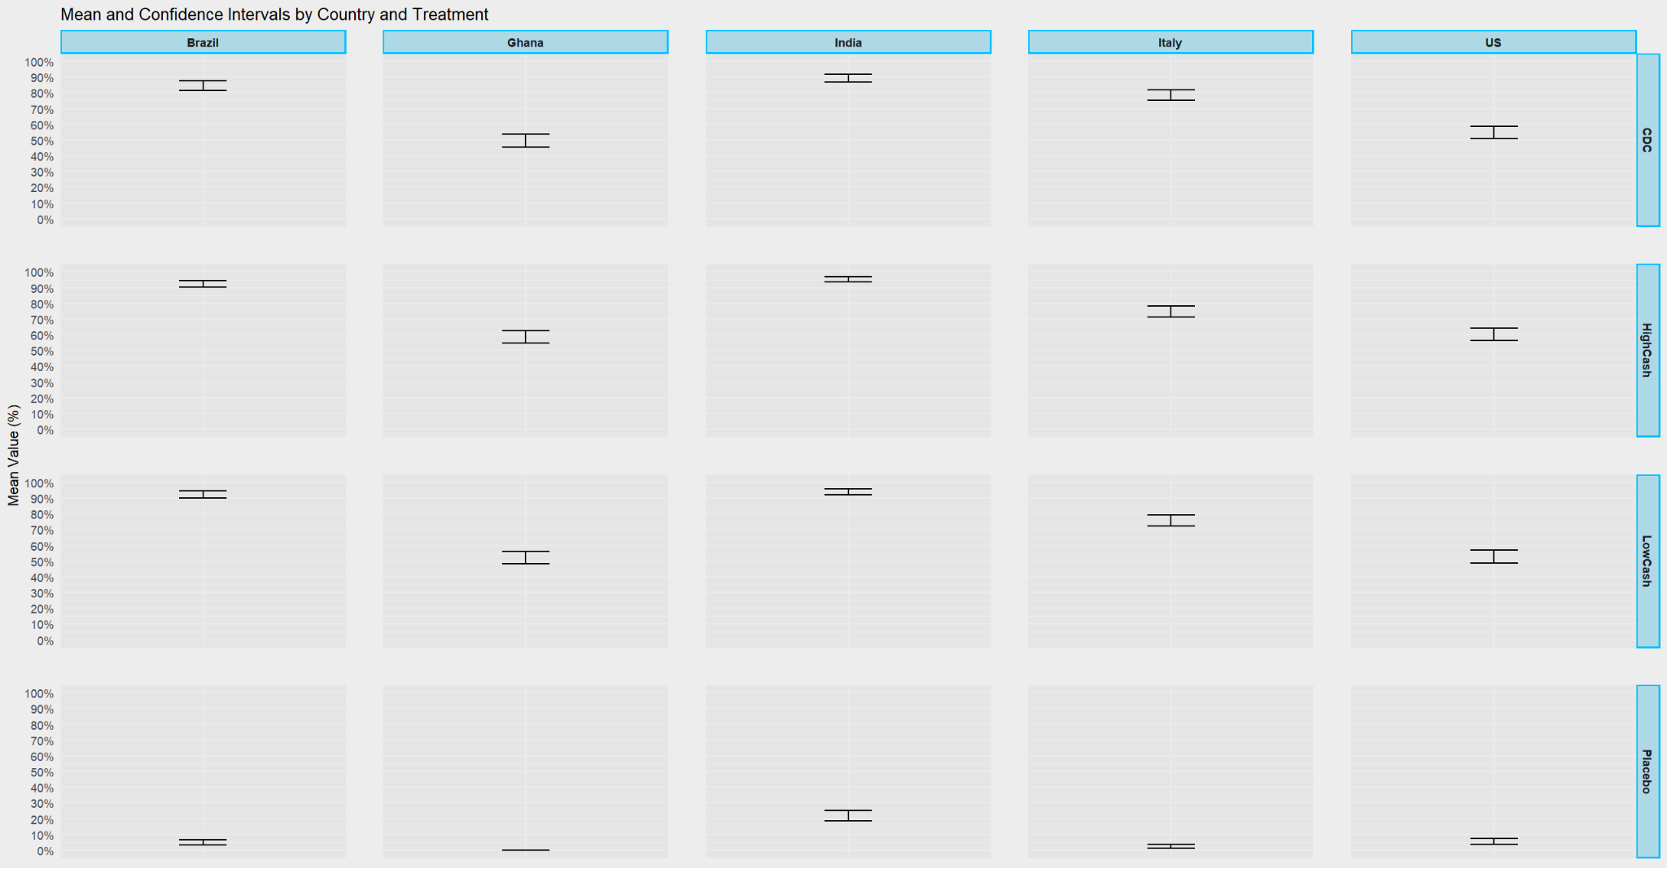

Slide 15
Ghana Financial Incentives Wave I RCT
6 Rural Districts/310 Villages
6,968 Humans
Extensive socio-demographics
COVID-19 Vaccine Uptake
Synthetic Experiment

Slide 16
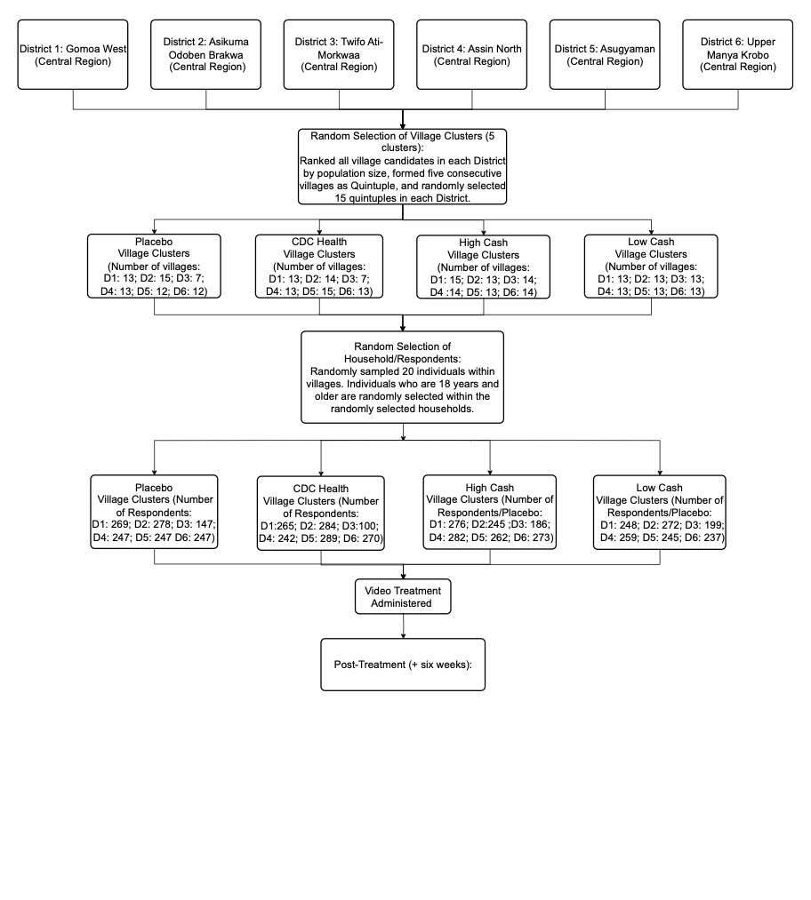

Slide 17
Conclusions
Results are encouraging but we are far from relying on these LLM experiments as guides to experimental treatment effects
Vaccine status responses similar for AI subjects and humans – But AI subjects unable to replicate the RCT treatment effects
16-countries: AI subjects also performed well in predicting the vaccination uptake for the persona created from subjects
16-countries: uneven replication of RCT treatment effects

