Slide 1
Artificially Intelligent RCTs
Leveraging Large Language Models for Synthetic Experimental Research
Raymond Duch · Tommaso Batistoni · Martina Beretta · Raymond Low · Benjamin S. Manning · Kento Ohara
University of Oxford · MIT
Talking to Machines · Delhi · March 2026

Slide 2
Motivation: The Case for Synthetic RCTs
Field RCTs are the gold standard — but costly
High financial cost, lengthy timelines, and logistics barriers limit the speed and scale of evidence generation in low- and middle-income countries (LMICs).
External validity is often unclear
Findings from one context may not generalise; policy relevance depends on scalability across settings.
LLMs raise a new possibility
If AI agents approximate human decision-making in structured experimental settings, synthetic RCTs could complement field experiments at a fraction of the cost.
$1K+
average cost per
RCT respondent
2–5 yr
typical field trial
duration
110+
LMICs where
evidence is thin
Duflo (2017); List (2024)
2 / 16

Slide 3
OBJECTIVE
Can AI agents replicate the treatment
effects of real-world field RCTs?
Under what conditions, and to what extent, can LLM-powered AI agents simulate human participants – thereby replicating treatment effects from an existing RCT in a highly context-specific, underrepresented-population setting?
If yes: synthetic RCTs become a low-cost, scalable complement to field experiments — particularly for the Global South.
4 / 16

Slide 4
Project Overview: AI-RCTs Framework
Efficiency gains from synthetic RCTs are a function of LLM accuracy in simulating human behavior.
How to specialize an LLM for this task?
Hypothesis: Additional fine-tuning on context- and domain-specific data, such as survey and RCT datasets, can boost LLM ability to replicate human outcome distributions and treatment effects.
Development Phases & Diagnostic
I
II
III
Exploratory
Pre-Test
Full RCT
Replication
Generalization
& New Contexts
Optimization of fine-tuning hyper-parameters via (restricted) grid search
Synthetic Ghana trials
compared to human
treatment effects
New LMICs, new
health interventions,
new policy domains
3 / 16

Slide 5
Phase I – Road Map
Three diagnostic phases – the overall objective is to optimize fine-tuning protocols
CURRENT
Ia
Ib
Ic
Unconditional
Distribution
Conditional
Distribution
ML Benchmark
Money request game
[Gao et al., 2025]
Simulated
RCT
Benchmark vs.
standard ML models
Reproduce human outcome distribution
Approximate P(Y | T, X)
Logistic regression + random forest on same data
No treatment heterogeneity or covariates
Arbitrarily large sample size (10k training & 2k holdout)
Reference for predictive accuracy
Lower-bound test of distributional fidelity
Arbitrarily large treatment effects
Tests treatment effect direction & magnitude recovery
8 / 16

Slide 6
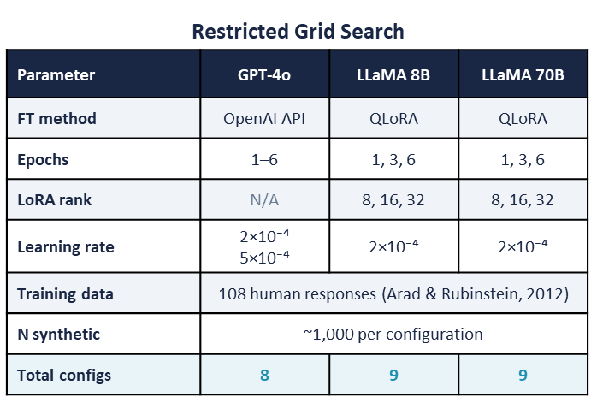
Phase Ia: Unconditional Distribution
Money request game [Gao et al., 2025; Arad & Rubinstein, 2012]
Test design
LLMs simulated the Arad & Rubinstein (2012) money request game: choose an integer 11–20. The task is purely distributional — no treatment assignment, no participant covariates.
Distributional fidelity
This provides a lower-bound test of distributional fidelity: can LLMs reproduce a simple, context-free human distribution?
Metrics: Jensen-Shannon (JS) Divergence, Mean, SD
Permutation tests assess whether observed divergence from the human distribution is statistically distinguishable from chance. Also test differences in means and SDs.
Models: GPT-4o & Llama 3.1 8B/70B
Gao et al. (2025, PNAS); Arad & Rubinstein (2012, AER)
9 / 16

Slide 7
Phase Ia Results: Unconditional Distribution
10 / 16

Slide 8
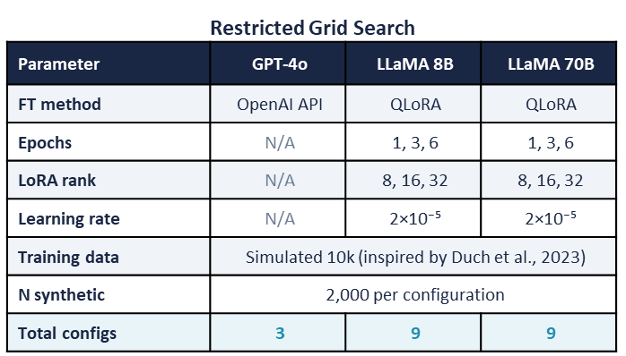
Phase Ib: Conditional Probability
P(Y | T, X)
Test design
Simulated dataset anchored to Duch et al. (2023)
Preservation of context and structure of treatment effects
Participant profiles simplified to 4 categorical covariates (i.e., age, gender, education, employment)
Arbitrarily large sample size
Arbitrarily large treatment effects
Simulated dataset
10k units in training
2k units in holdout
Conditional distributional fidelity
Can LLMs reproduce outcome distributions that are conditional to the treatment assigned to each unit?
Metrics: composite
Models: GPT-4o & Llama 3.1 8B/70B
11 / 16

Slide 9
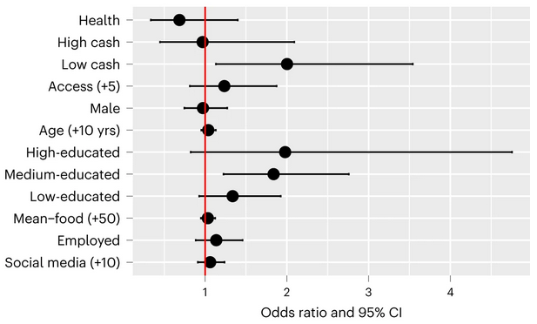
The Ghana Anchor Trial
Duch et al. (2023)
COVID-19 Vaccine RCT
Nature Medicine, Dec 2023
5,900 subjects · 310 villages
4 arms:
Placebo (message on solar panel)
Health message
Low cash ($3)
High cash ($10)
Key finding:
Cash incentives increased verified vaccination by +6.3pp vs. placebo (95% CI: 2.4–10.2; p=0.001)
Non-linear relationship b/w incentive and vaccine uptake: low incentive ($3) outperformed high incentive ($10)
5 / 16

Slide 10
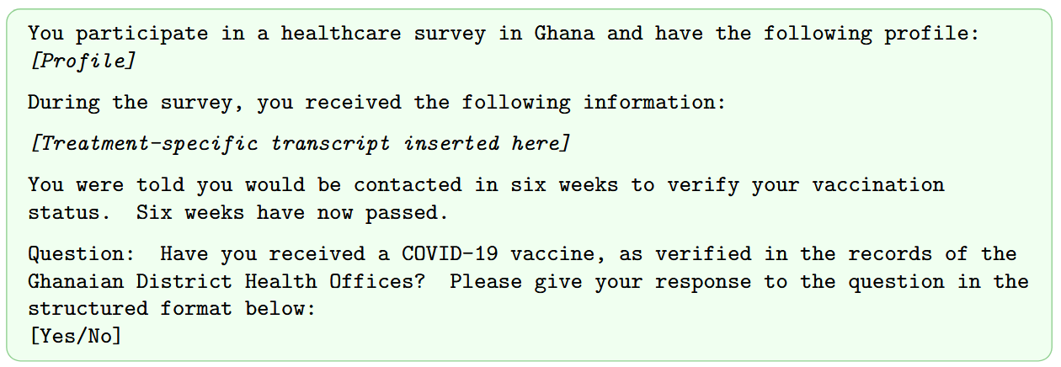
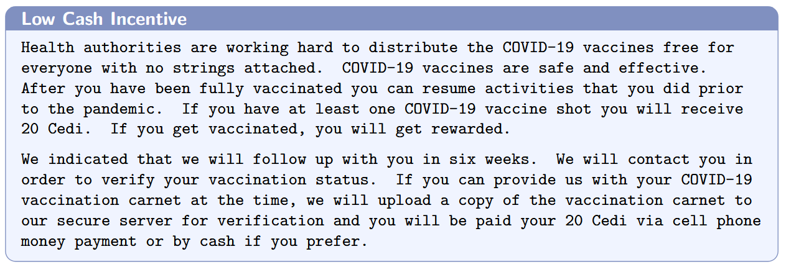
Prompts
6 / 16

Slide 11
Metrics: Composite Replication Score
Score = 0.50 × EffectDistance + 0.30 × HellingerComponent + 0.20 × CalibHetComponent
50%
A1 Effect-Size Distance
30%
A2 Per-Arm Hellinger
20%
A3 Calibration Heterogeneity
LogOR Distance
Distributional Match
CalHet
Logistic regression fitted on predictions. Log-OR distance between synthetic and human treatment effects, averaged across the 3 active arms (CDC Health, Low Cash, High Cash). Scaled 0–100; 0 = perfect match, 100 = ≥ 20× off.
dₖ = min(|log(ORₛ) − log(ORₕ)|, log 20)
EffDist = min(mean(dₖ) / log 20, 1) × 100
Hellinger distance between predicted and true outcome distributions within each of the 4 treatment arms, then averaged. Robust to class imbalance (sqrt-compresses small errors). Scaled 0–100.
H(p,q) = (1/√2) × √(∑(√pᵢ − √qᵢ)²)
HelComp = mean(Hₖ) × 100
SD of per-arm calibration errors (predicted rate minus true rate). Distinguishes uniform miscalibration (less harmful — preserves relative treatment structure) from differential miscalibration across arms. Scaled 0–100.
CalHet = SD(calib_err₁, ..., calib_errₖ)
CalHetComp = min(CalHet / 20, 1) × 100
Continuous replication analogue
Within-arm distributional fidelity
Differential arm miscalibration
Diagnostic indicators (not in composite core):
Rep (X/3) · Direction matches · CI inclusion · MAE · Degenerate flag
7 / 16

Slide 12
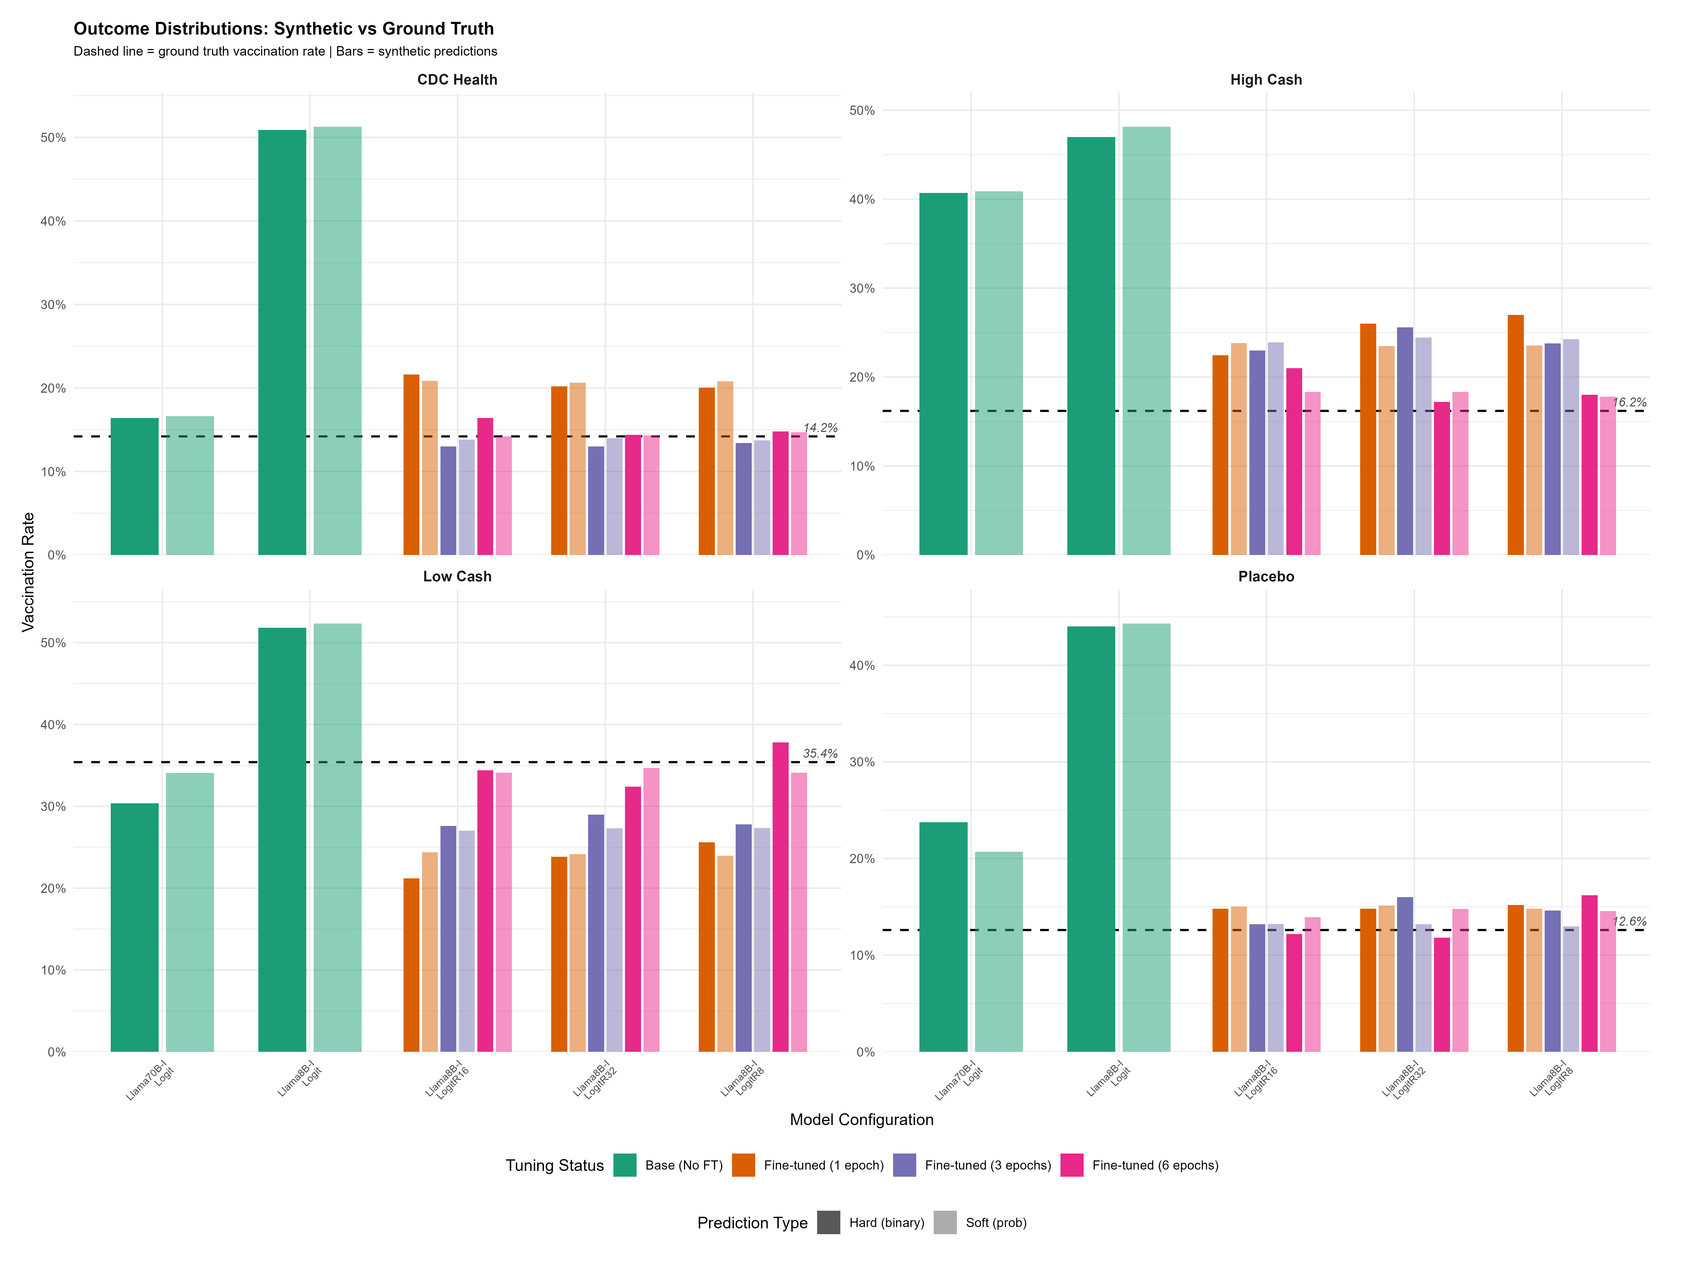
Phase Ib Results: Conditional Distribution
12 / 16

Slide 13
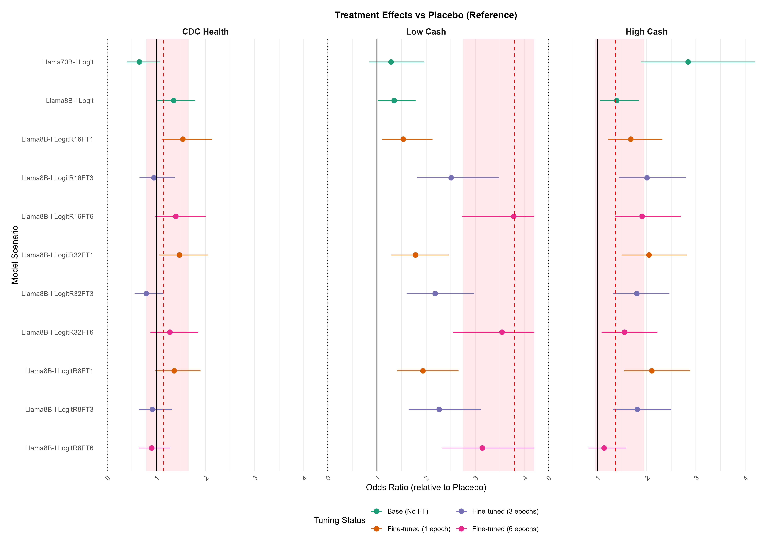
Phase Ib Results: Conditional Distribution
12 / 16

Slide 14
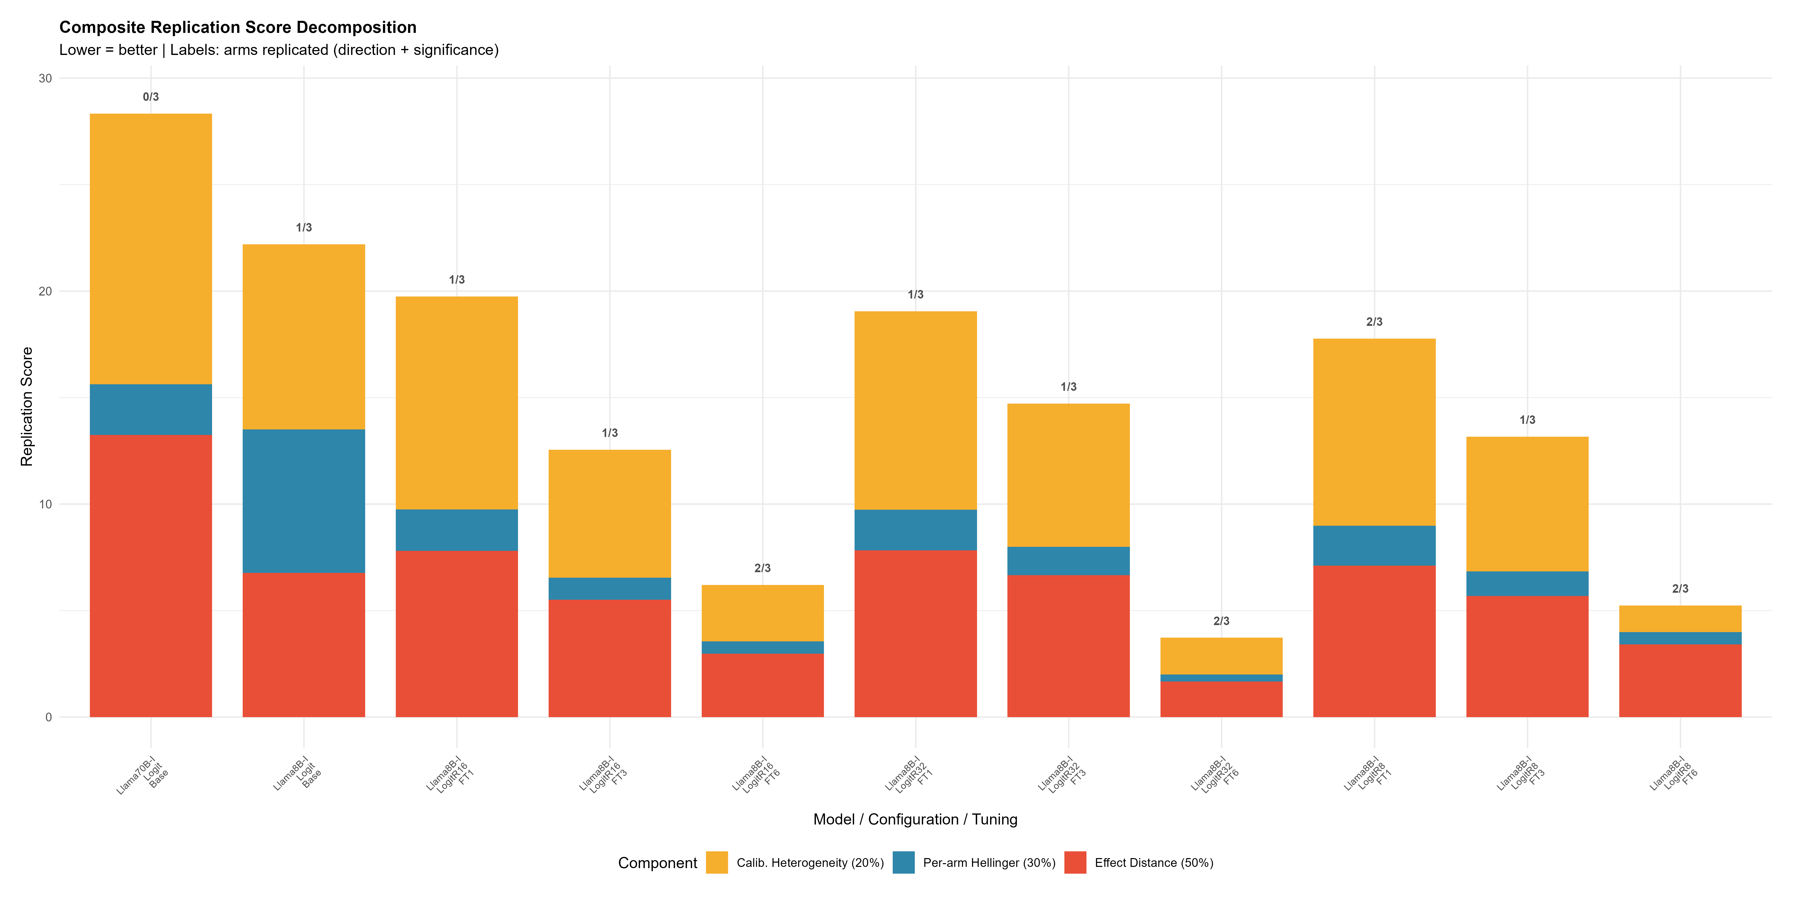
Phase Ib Results: Conditional Distribution
12 / 16

Slide 15
Phase II: Full RCT Synthetic Replication
P(Y | T, X)
Test design
Synthetic replication of Duch et al. (2023)
Preservation of full participant profiles in both training and inference phases – i.e., 19 covariates, including information on socio-economic status, social network, and social media use
Bounded to original sample size
Bounded to original treatment effects magnitude
Dataset
1538 units in training
1537 units in holdout
Conditional distributional fidelity
Can LLMs reproduce the outcome distributions of Duch et al. (2025)?
Metrics: composite
Models: GPT-4o & Llama 3.1 8B/70B with fine-tuning regime derived from Phase I
11 / 16

Slide 16
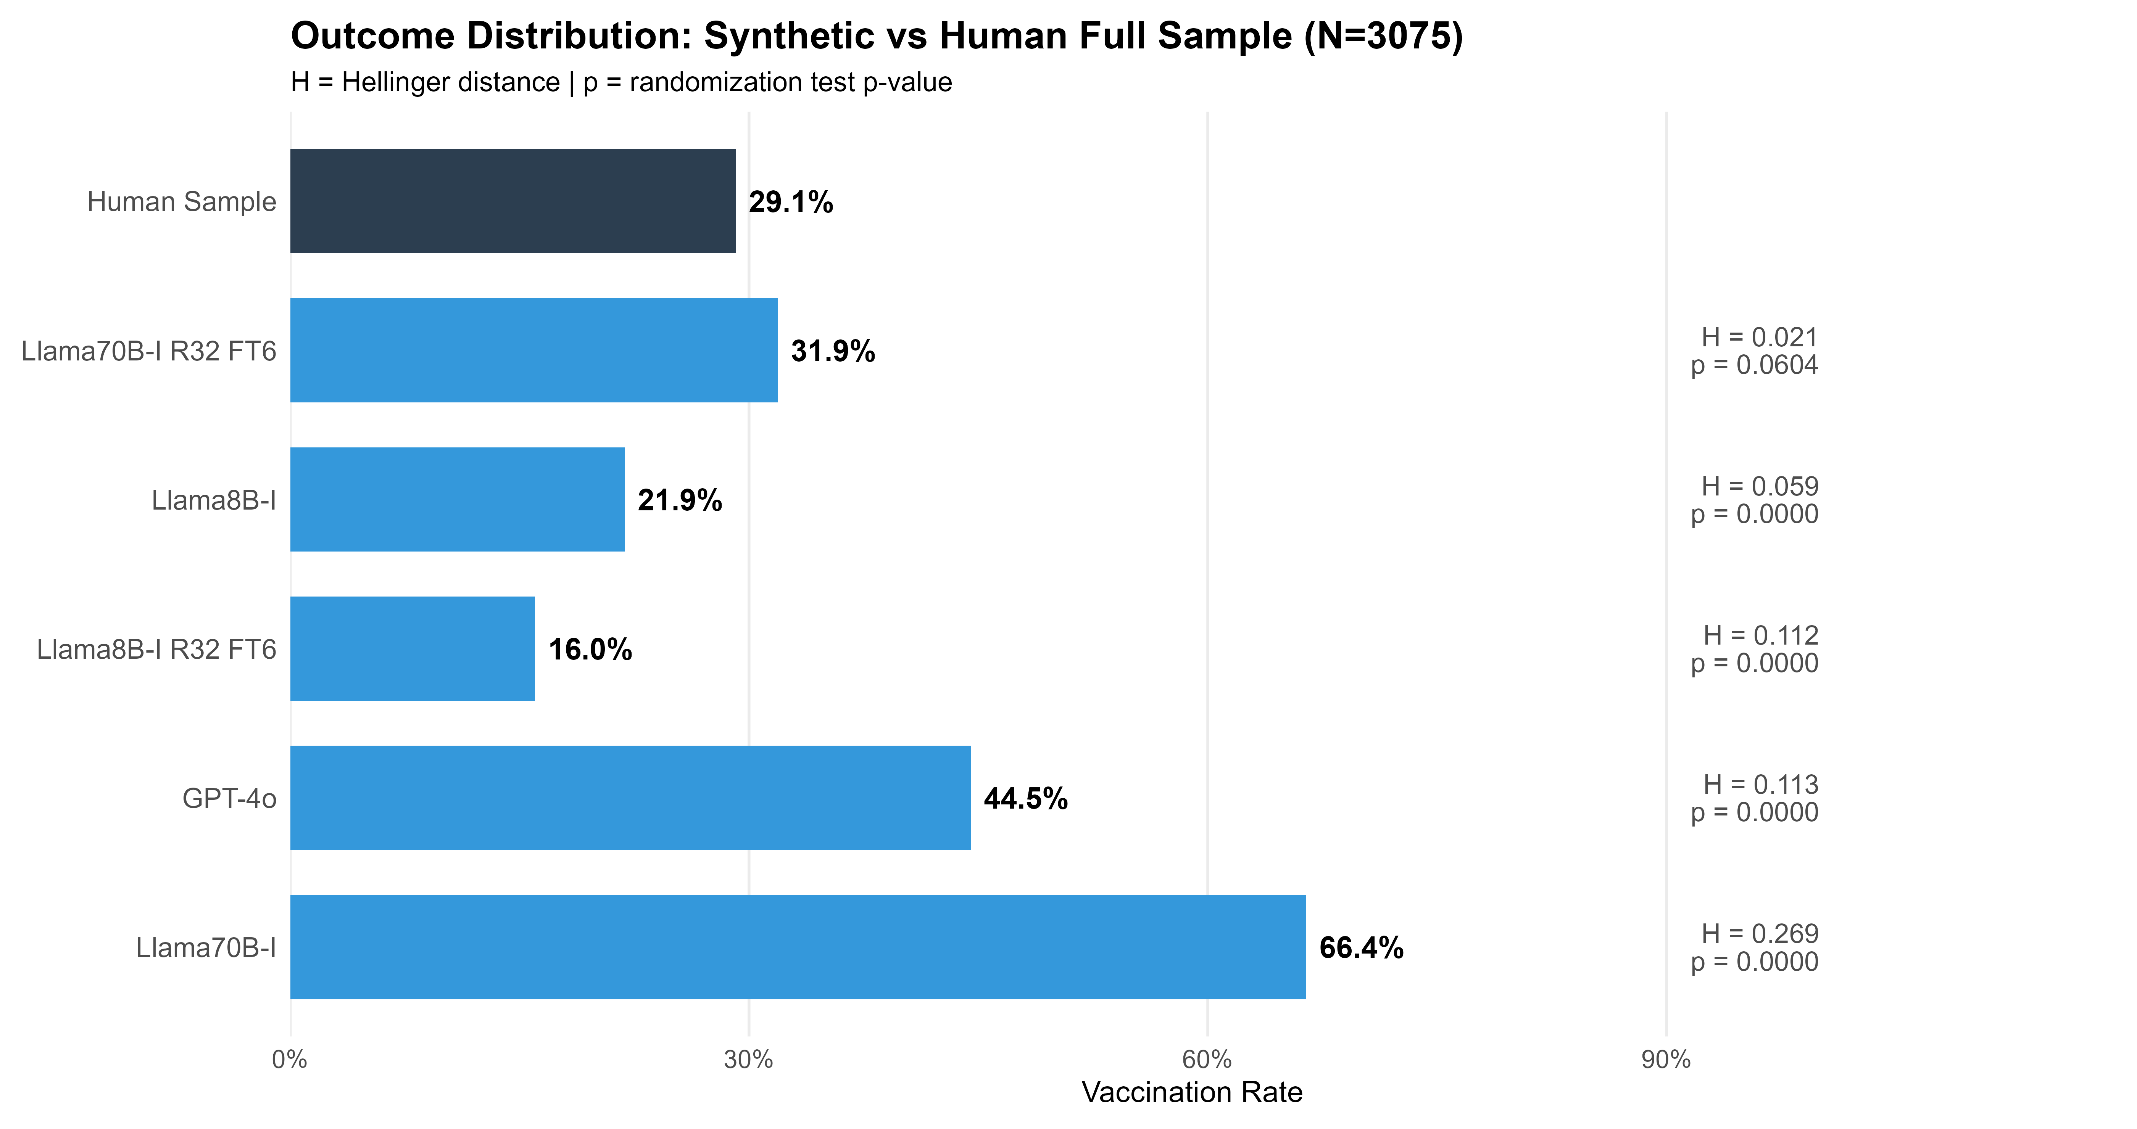
Phase II Results (Bench: Full Human Sample)
10 / 16

Slide 17
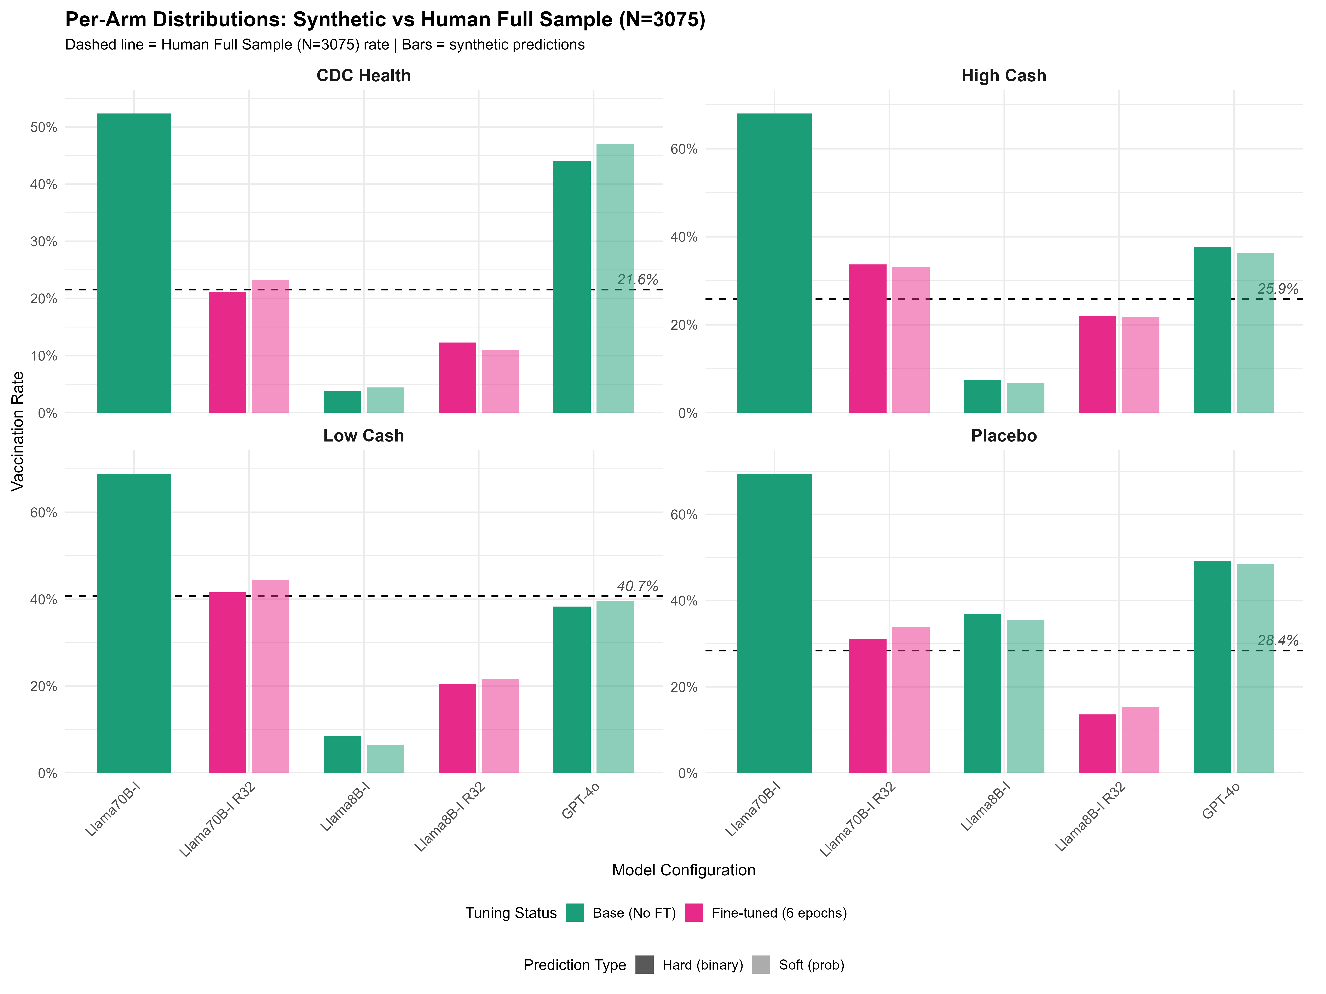
Phase II Results (Bench: Full Human Sample)
10 / 16

Slide 18
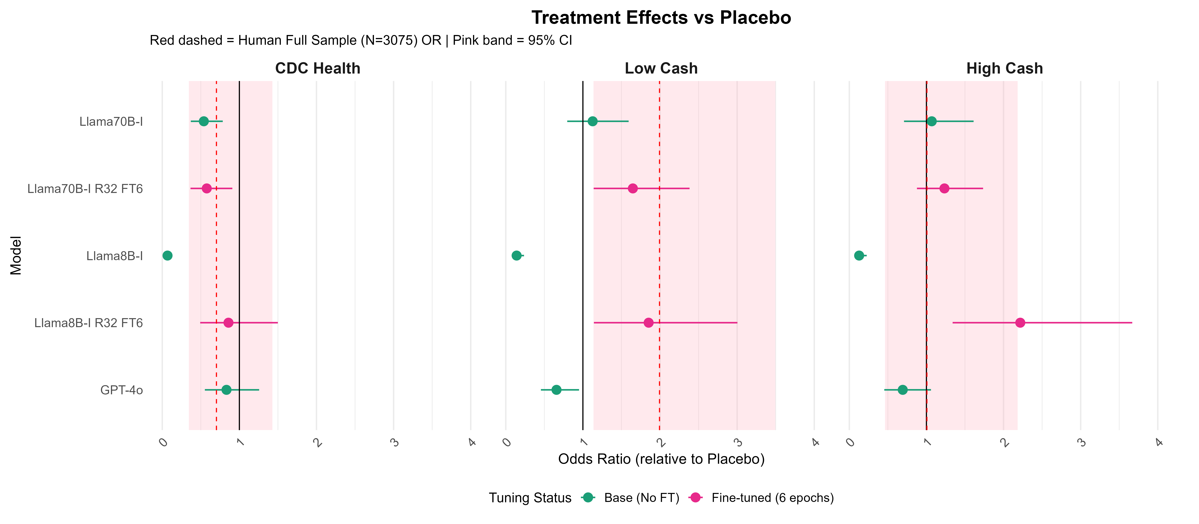
Phase II Results (Bench: Full Human Sample)
10 / 16

Slide 19
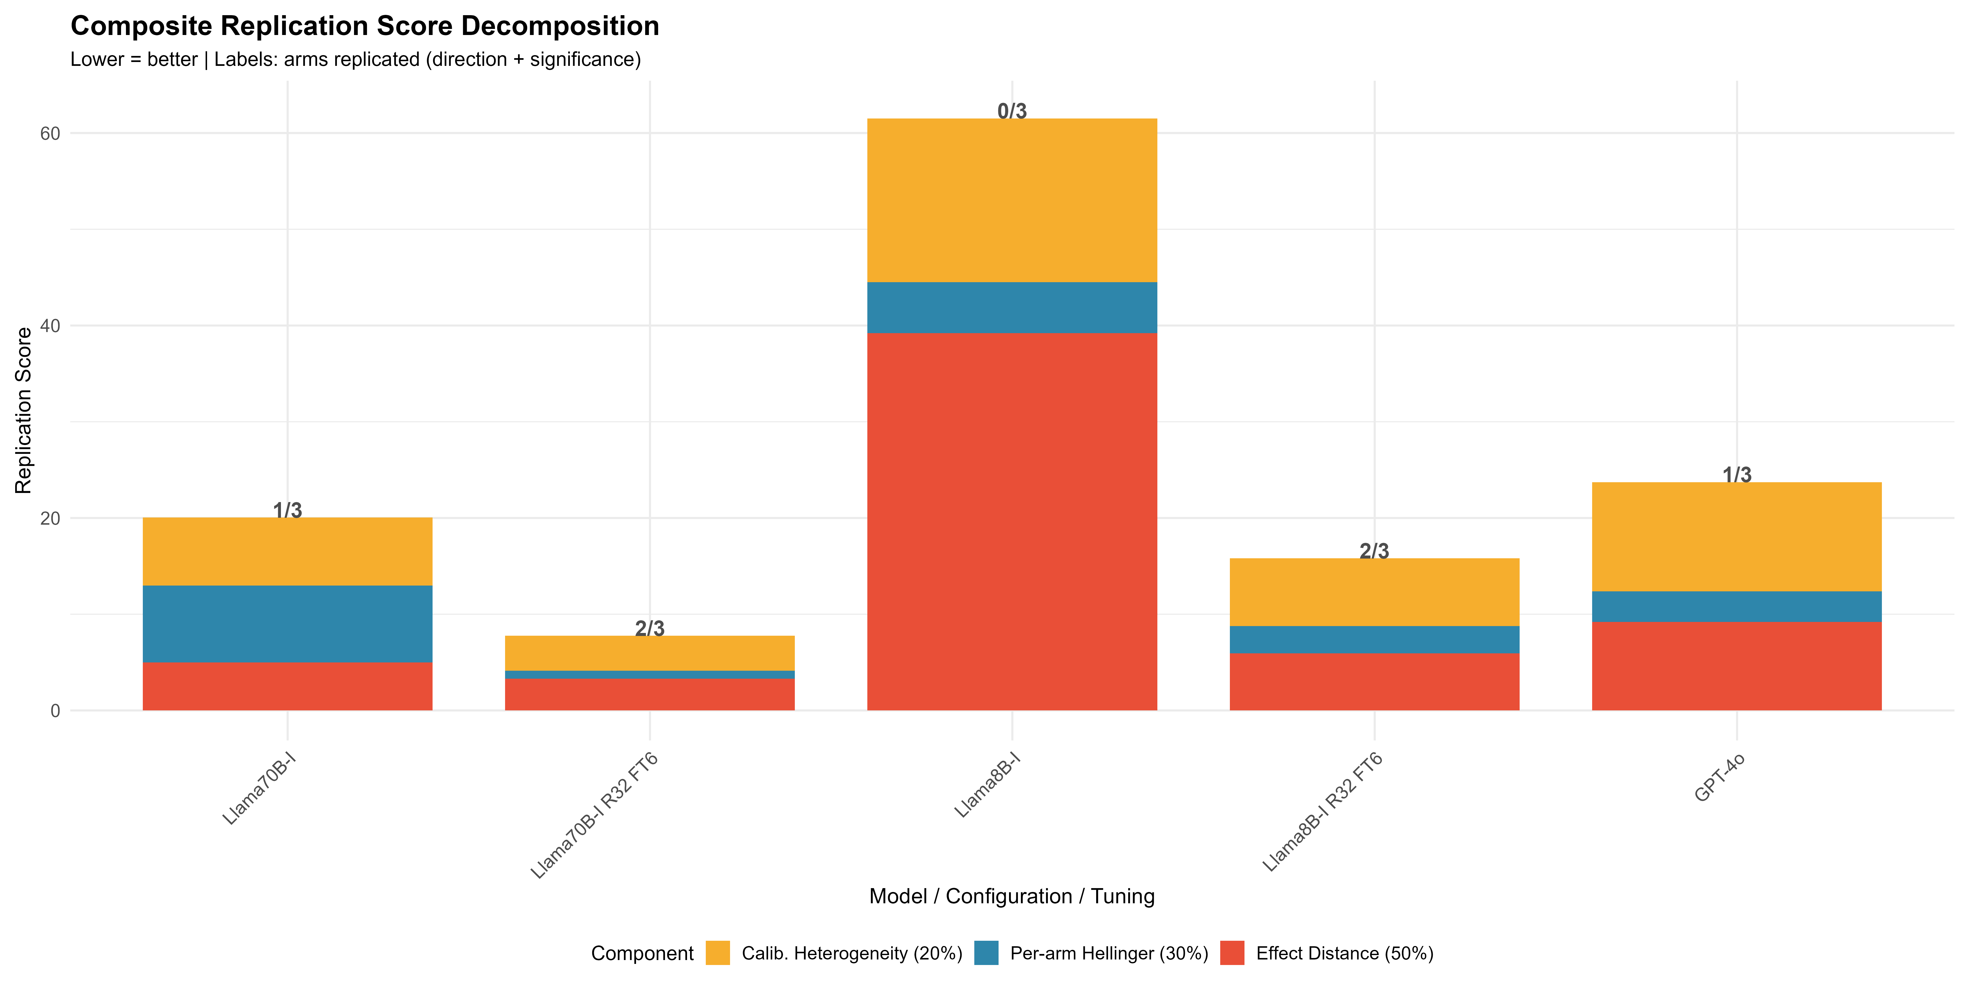
Phase II Results (Bench: Full Human Sample)
10 / 16

Slide 20
Looking Ahead...
Alternative Technologies
Generalisation & New Contexts
Retrieval Augmented Generation
Grounding predictions in external knowledge without retraining
Facilitate the integration of qualitative/ethnigraphic data
Digital Twins
Persistent dynamic agent profiles calibrated to individual data
Support longitudinal/counterfactual simulations across interventions
Prompting
Theory-driven engineering (CoT, persona framing) without parameter updates
Lowest-cost intervention combinable with FT and RAG
Extend beyond the Ghana anchor trial to test the scope of the synthetic RCT methodology
Planned extensions:
Greater distance b/w training and test data
New geographic contexts and populations
Diverse health intervention types
Non-health policy domains
Key question:
What contextual factors determine when synthetic replication succeeds or fails?
15 / 16

Slide 21
CONCLUSION
Towards scalable, low-cost synthetic RCTs for the Global South
01
Diagnostic-first approach - Three-phase diagnostic and optimization framework helps identifying fundamental LLM limitations.
02
Fine-tuning is the key lever - Model x LoRA ranks x training depth is the primary determinant of distributional replication fidelity. The composite replication score (Effect + Hellinger + CalHet) provides a principled basis for model selection.
03
If validated, the implications are large - Synthetic RCTs could dramatically reduce the cost and timeline of evidence generation for health and development policy - especially in contexts where field experiments are slow or infeasible.
raymond.duch@politics.ox.ac.uk
16 / 16

